Slide 1

This is the end!
Thank you for your attention.
Cheng-Jun Wang
wangchengjun@nju.edu.cn

Slide 2
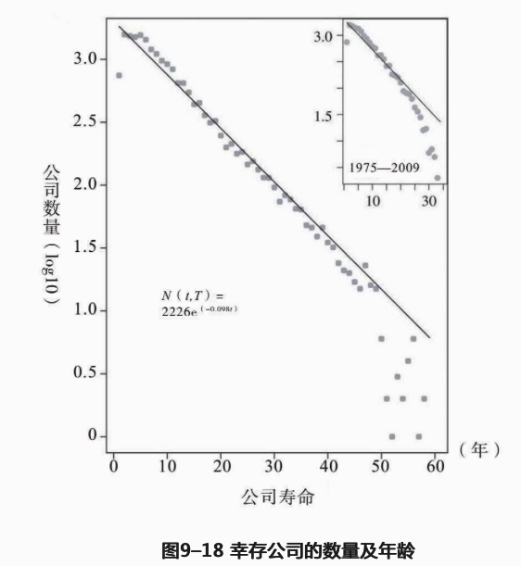

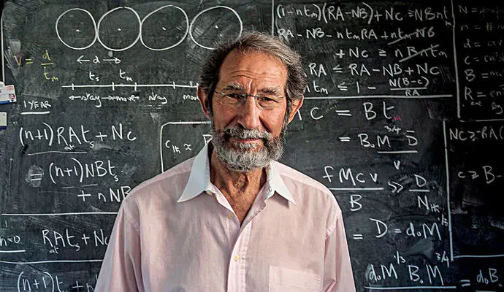

Slide 3
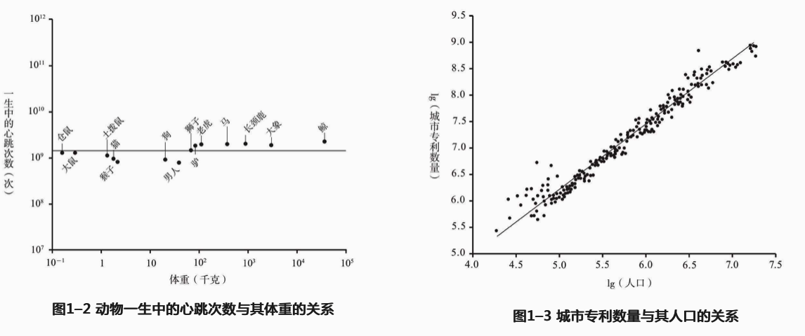
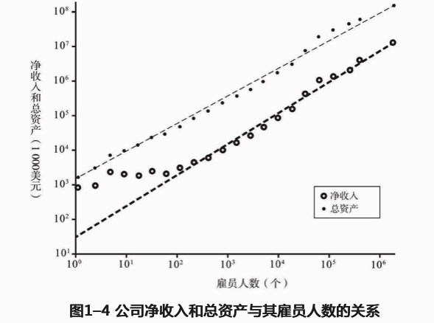
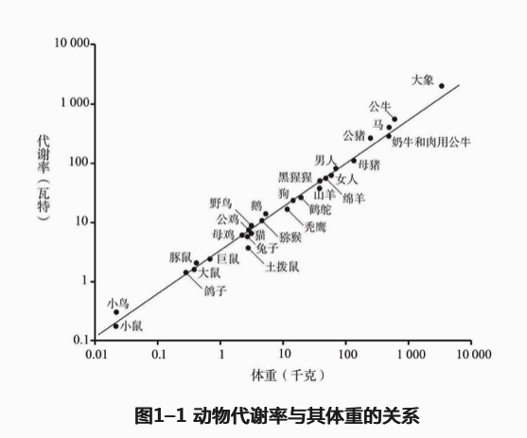

Slide 4
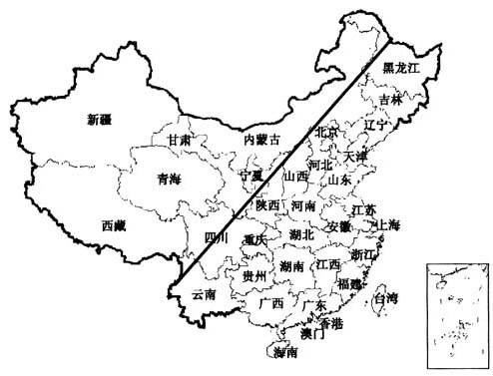
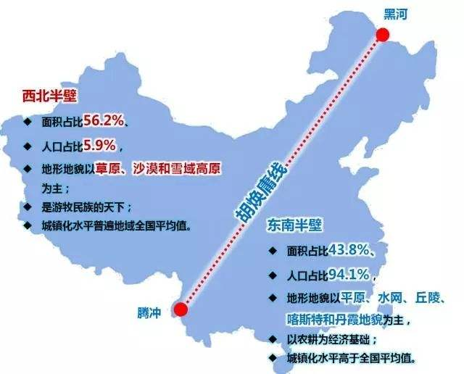
胡焕庸线

Slide 5
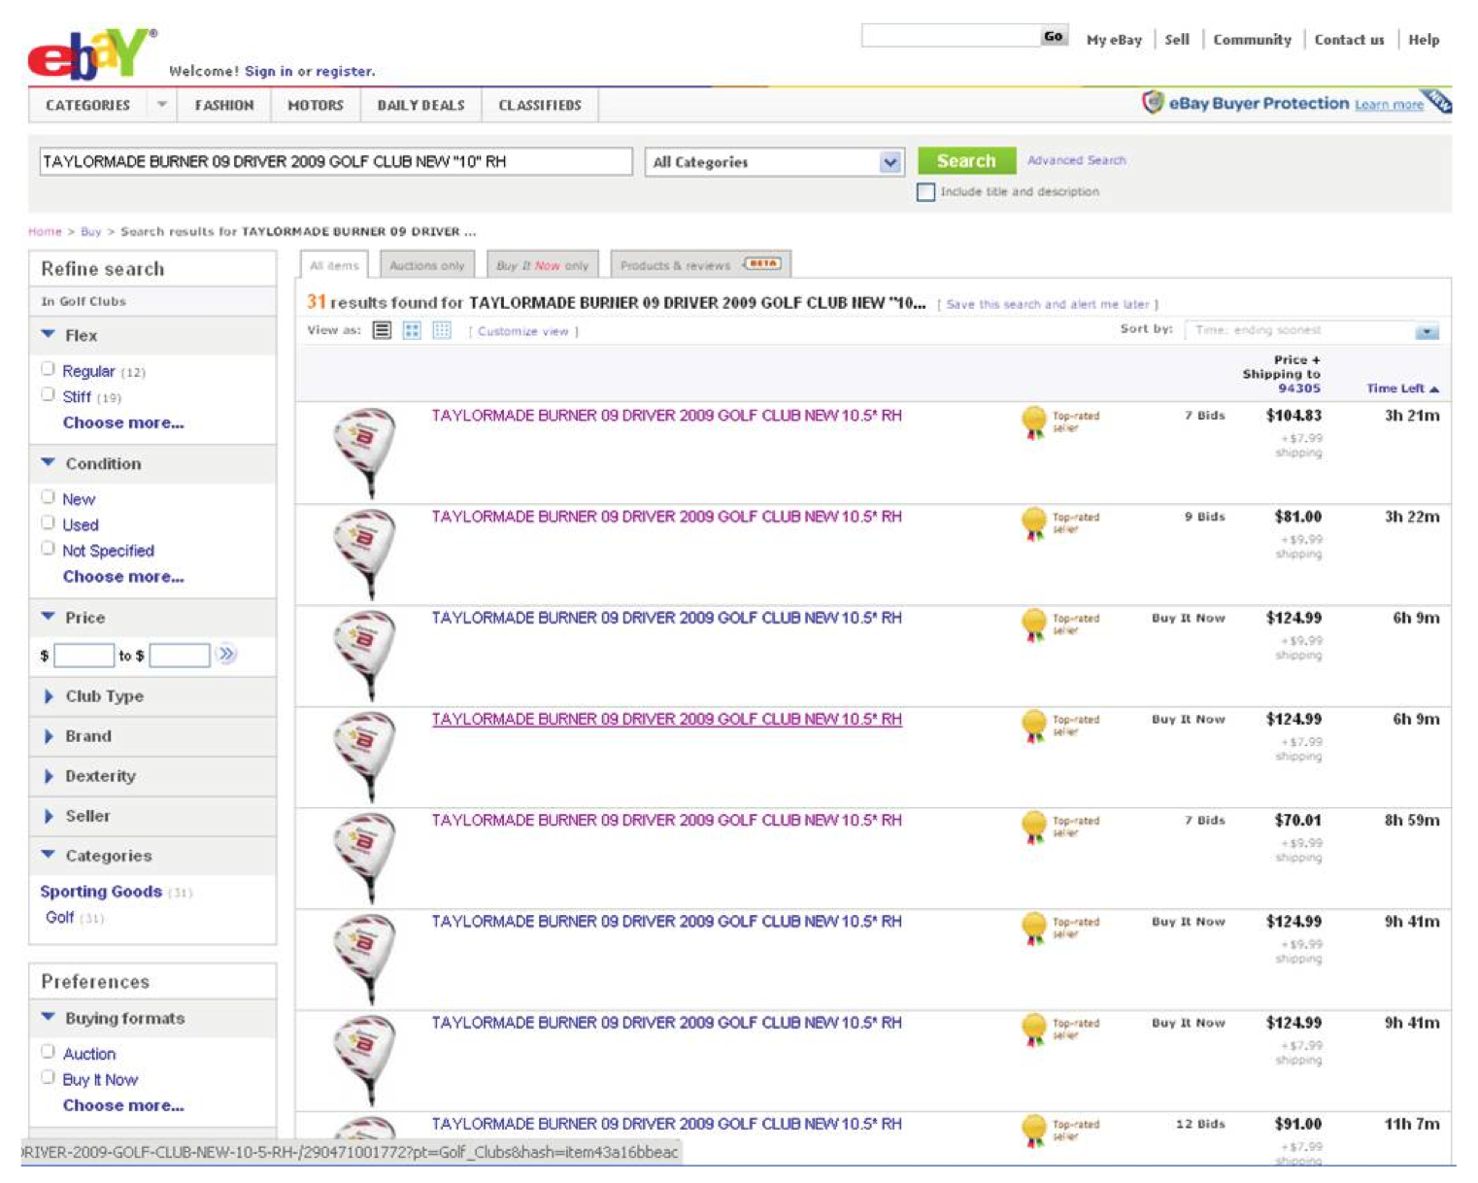

Slide 6

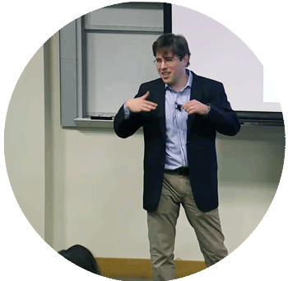

Bit by Bit is an invaluable resource for social scientists who want to harness the research potential of big data and a must-read for data scientists interested in applying the lessons of social science to tomorrow's technologies.
Matthew J. Salganik is professor of sociology at Princeton University
Cheng-Jun Wang
wangchengjun@nju.edu.cn

Slide 7
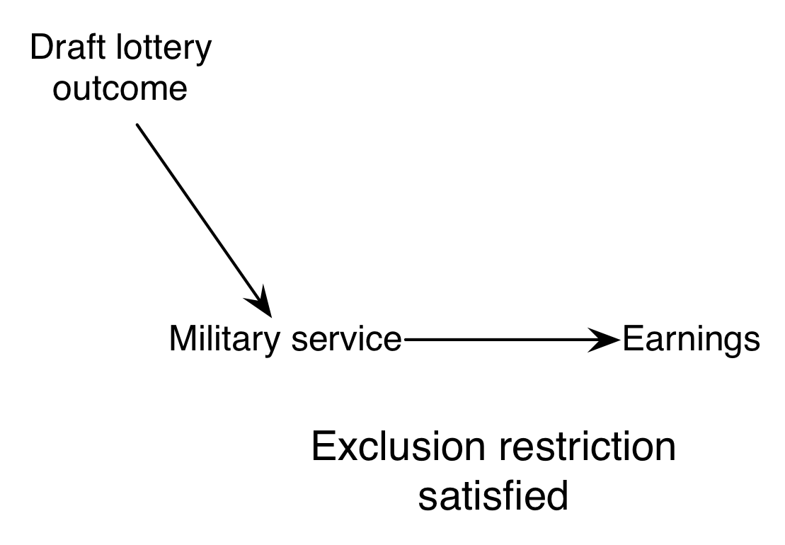
Z
ρ=Φ*λ
ITT_{Y} = ITT_{W} * CACE
Φ
ITT_{W}
Y
X
CACE
λ

Slide 8
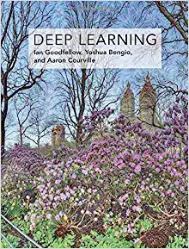
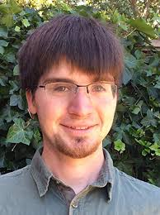
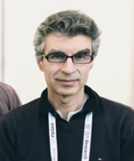
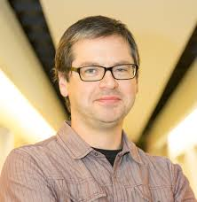
Deep Learning
Ian Goodfellow, Yoshua Bengio and Aaron Courville
2016 MIT Press
http://www.deeplearningbook.org

Slide 9
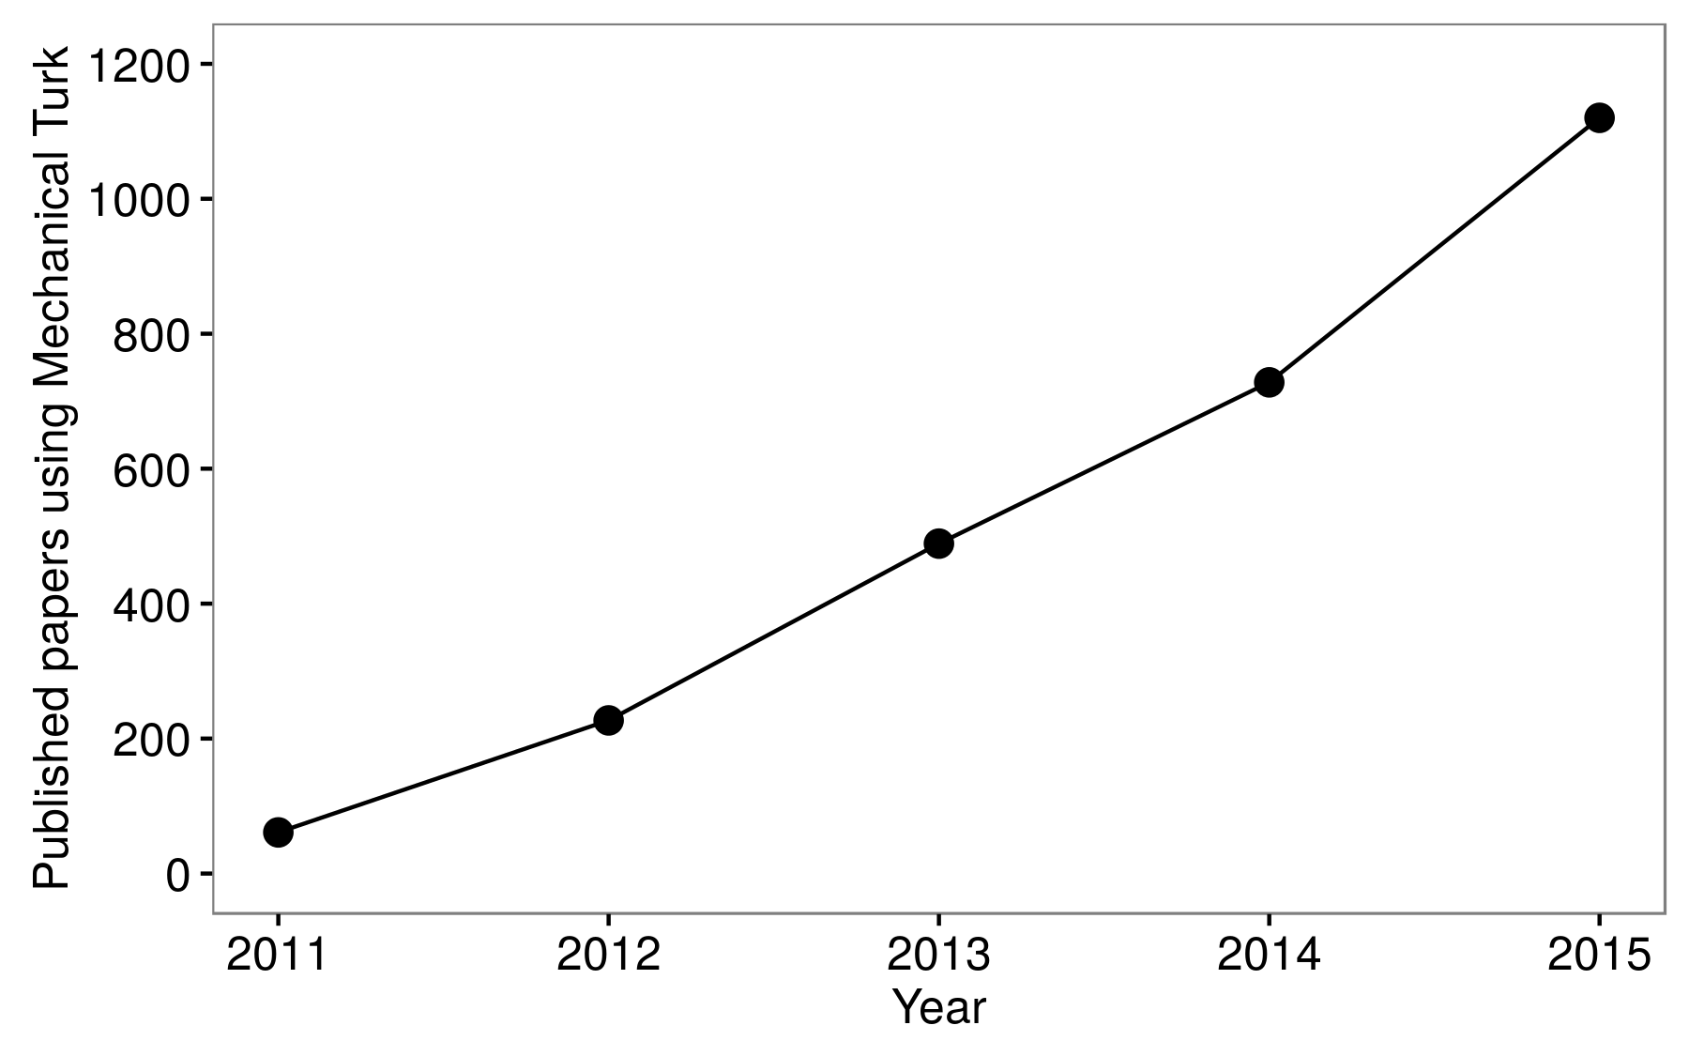

Slide 10


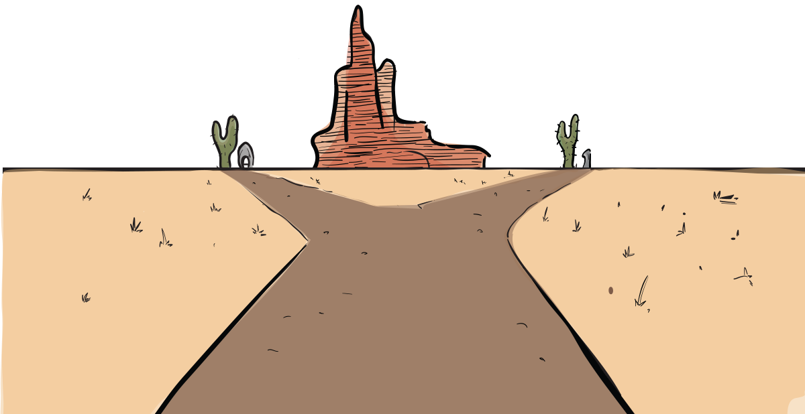
Joshua D. Angrist
Jörn-Steffen Pischke
Mastering ‘Metrics
The Path from Cause to Effect

Slide 12
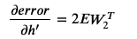
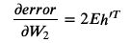
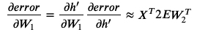
y = h’W₂
h’= relu(h)
h = X W₁
w₂
X
w₁
Computational Graph

Slide 13
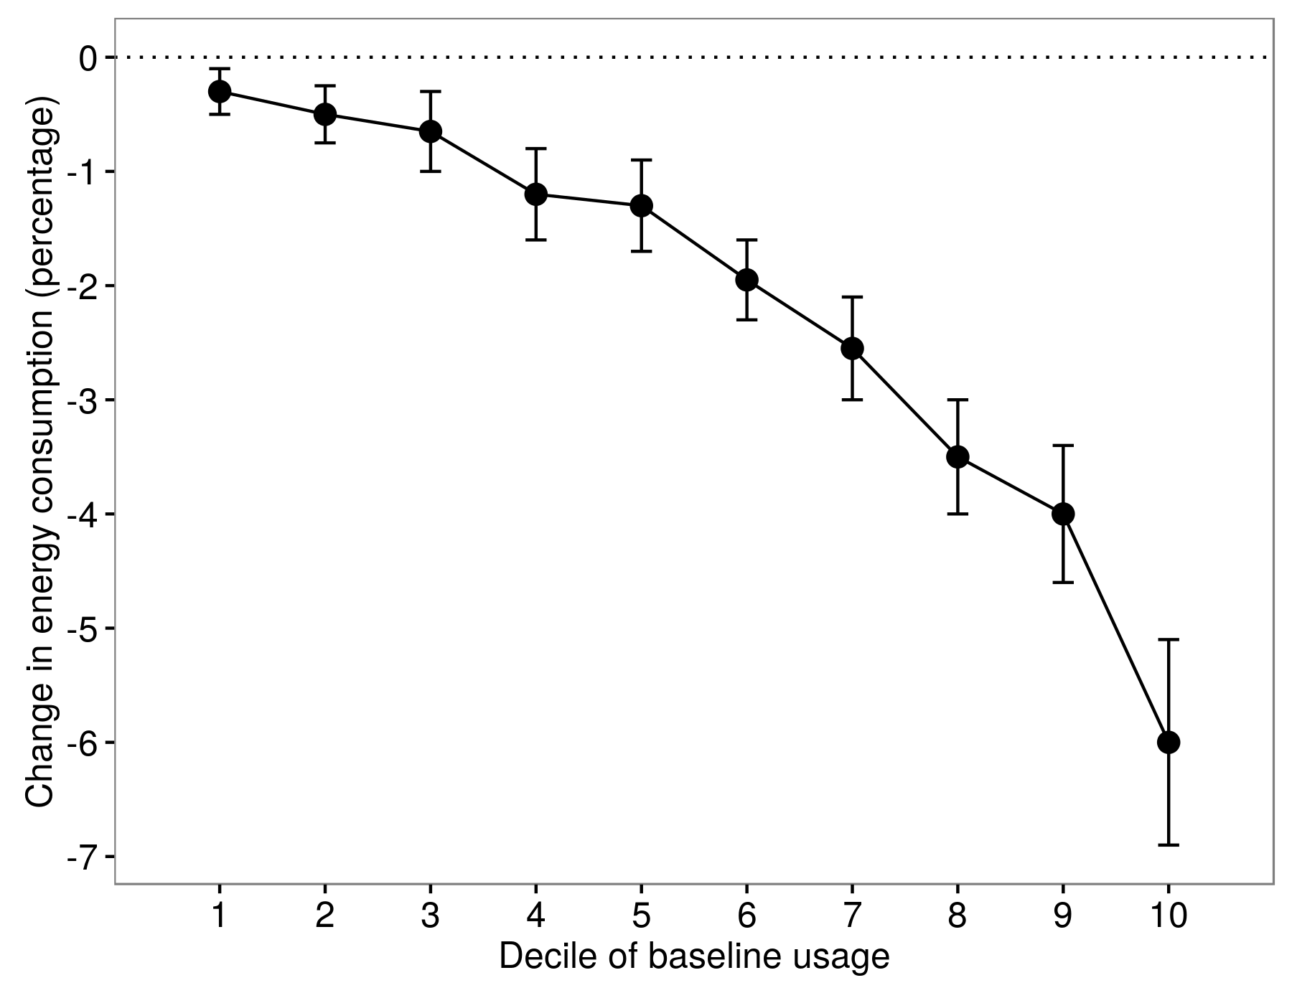
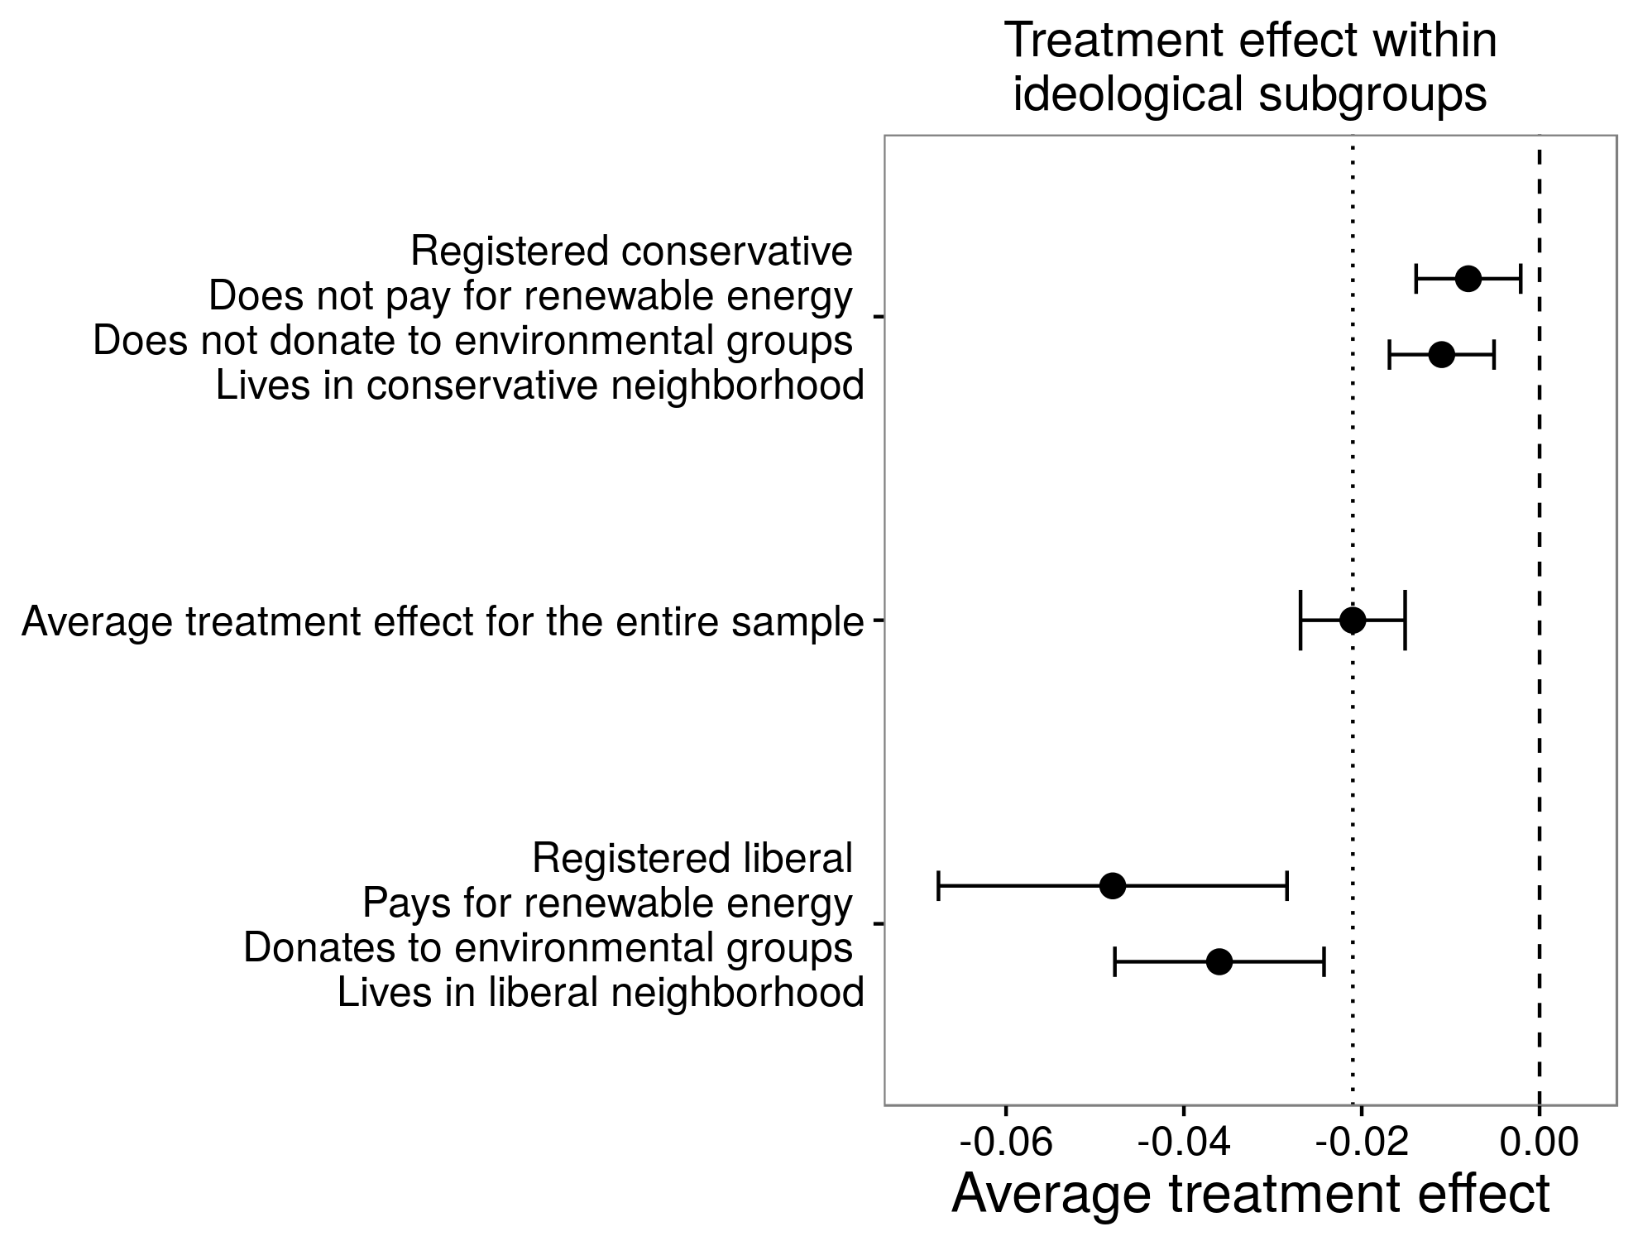
Allcott (2011)
Costa and Kahn (2013)
Light users
Heavy users

Slide 14
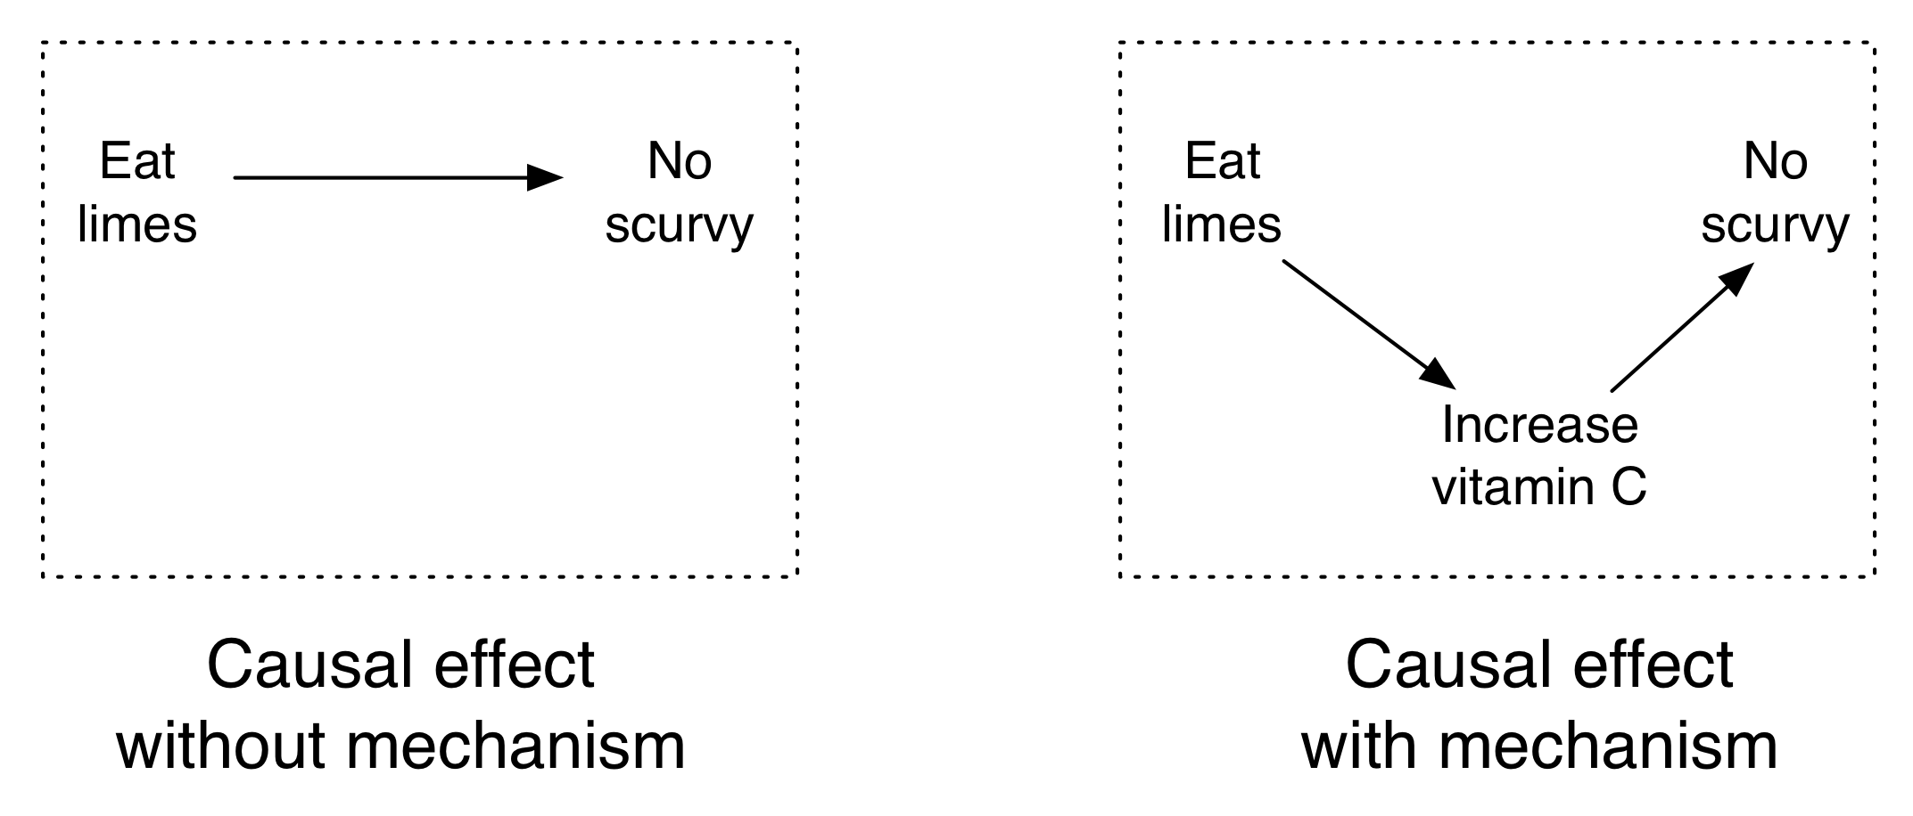
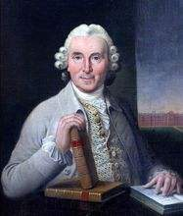
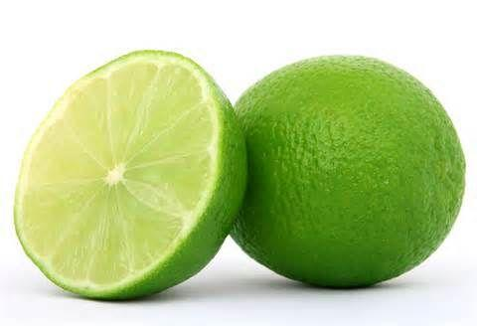

坏血病
James Lind

Slide 15
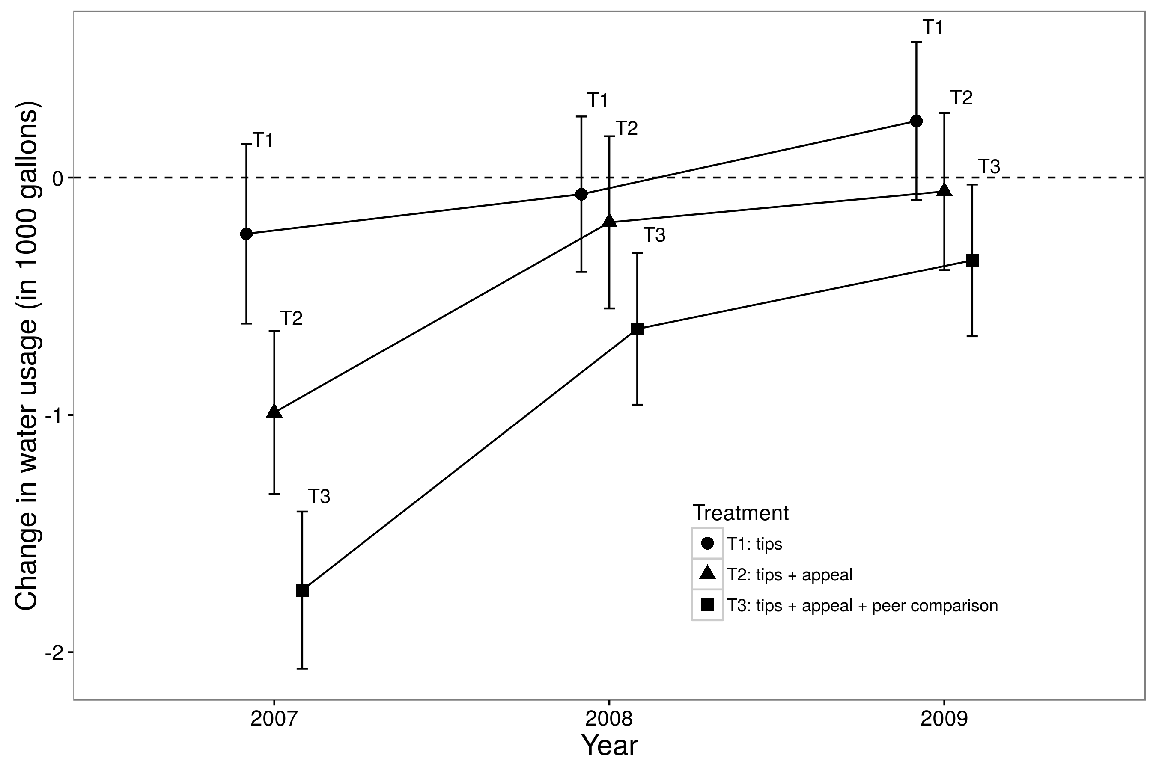

Slide 16
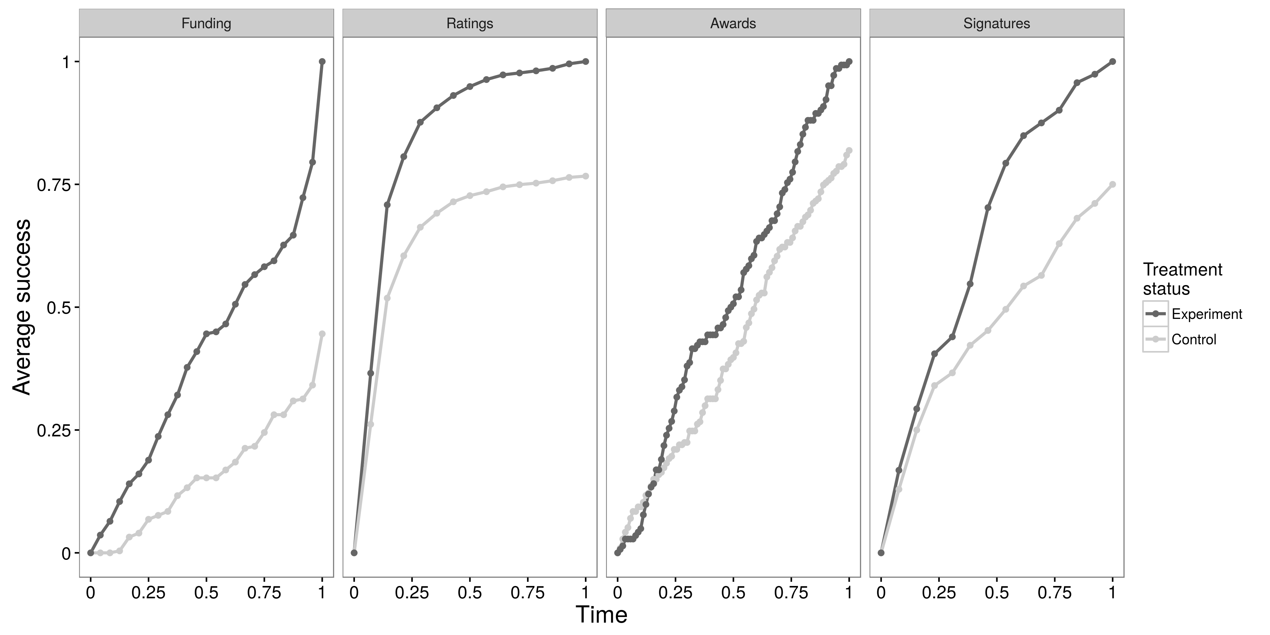
Kickstarter
Epinions
Wikipedia
change.org.

Slide 17
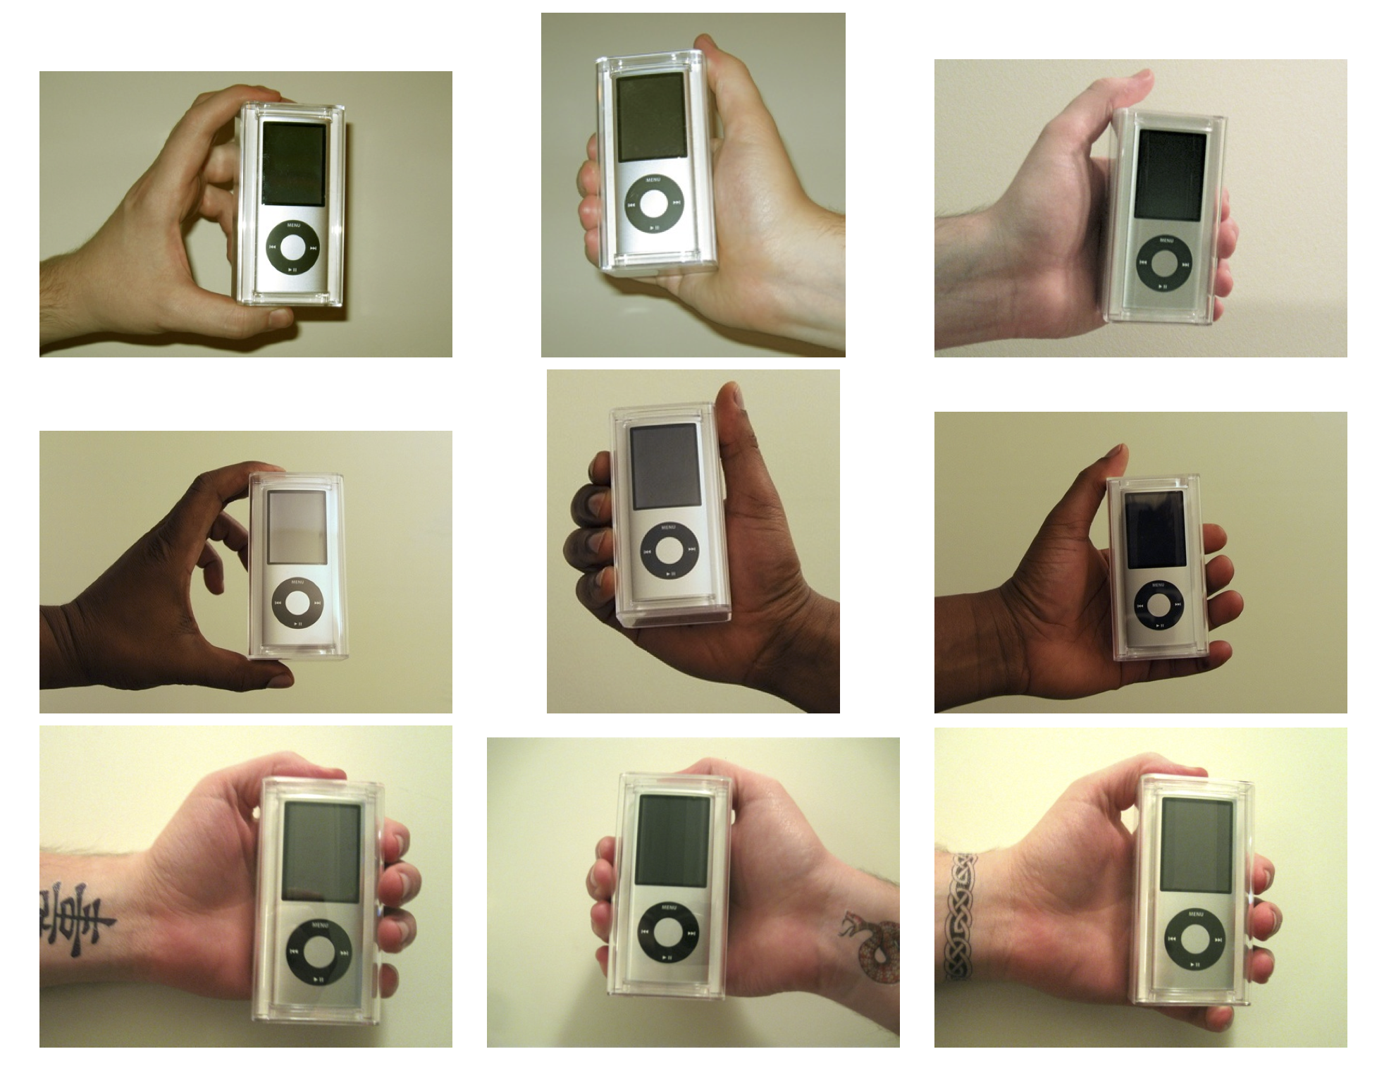

Slide 18
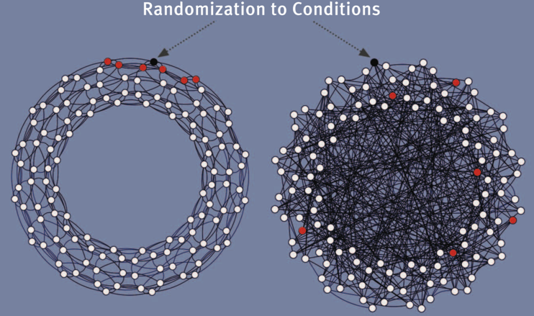
Clustered Network
Random Network

Slide 19


more research
better products
more users
A group of researchers at the University of Minnesota created MovieLens, which provides free, noncommercial personalized movie recommendations.
https://movielens.org/

Slide 20
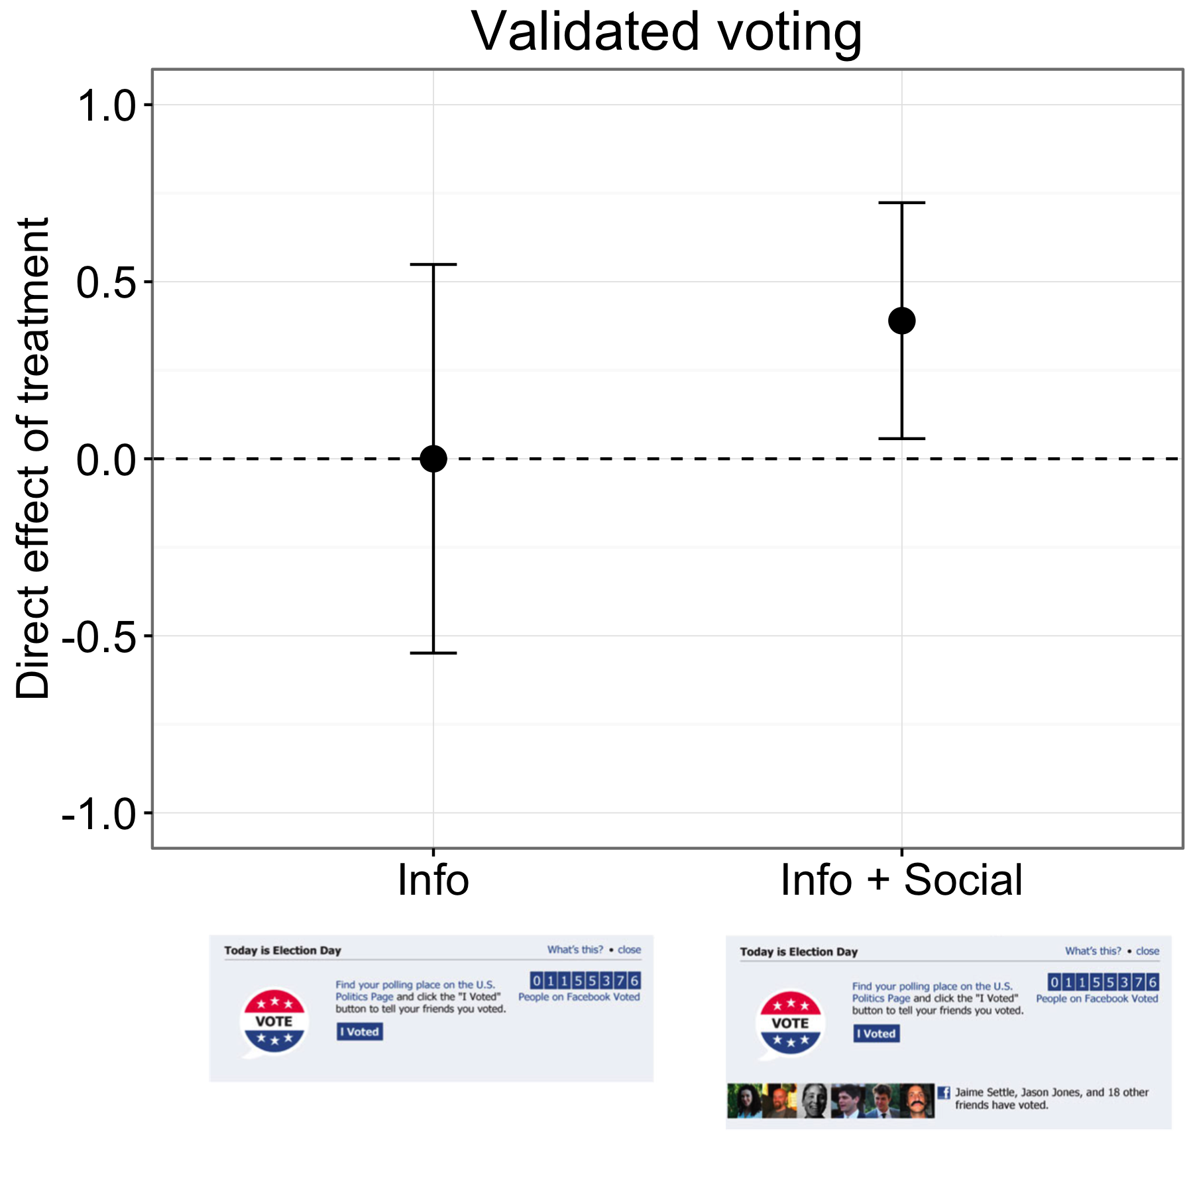
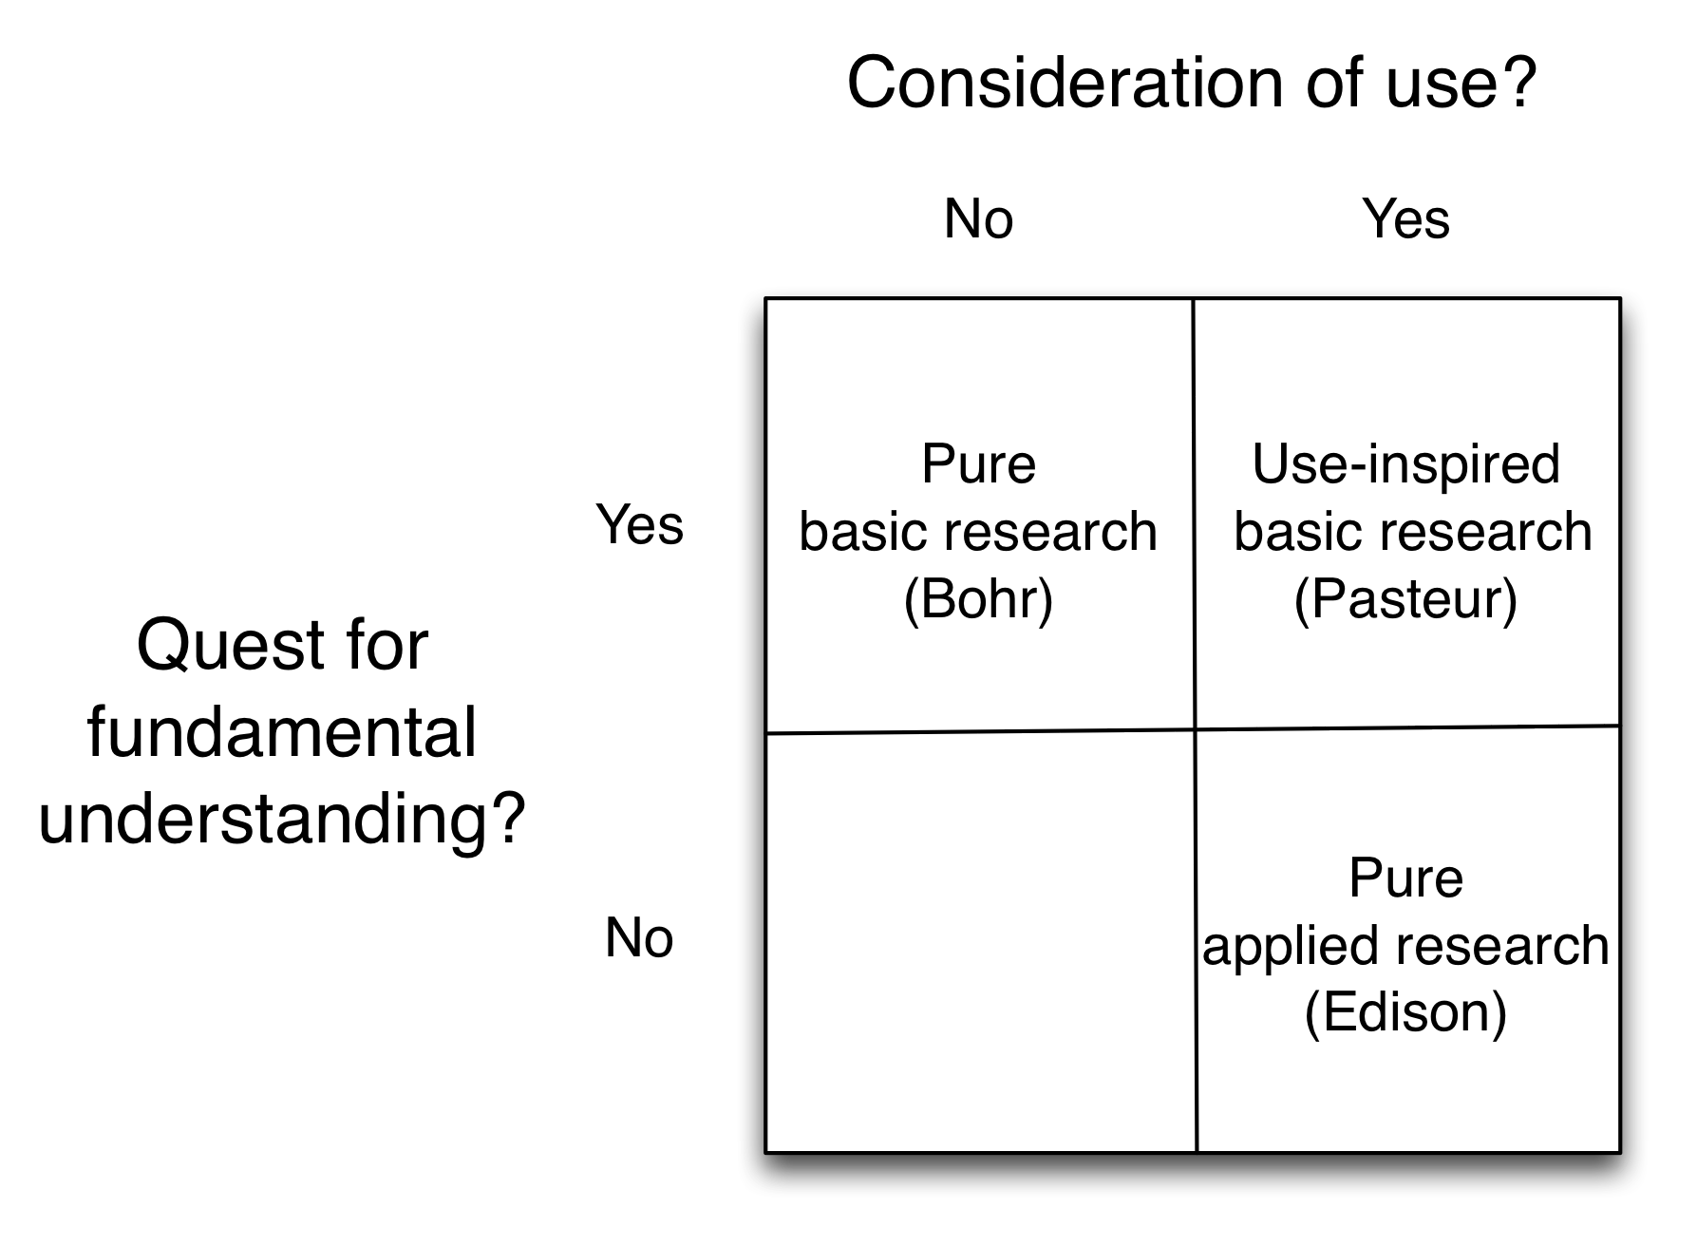
98% of the sample was assigned to Info + Social.
1%

Slide 21


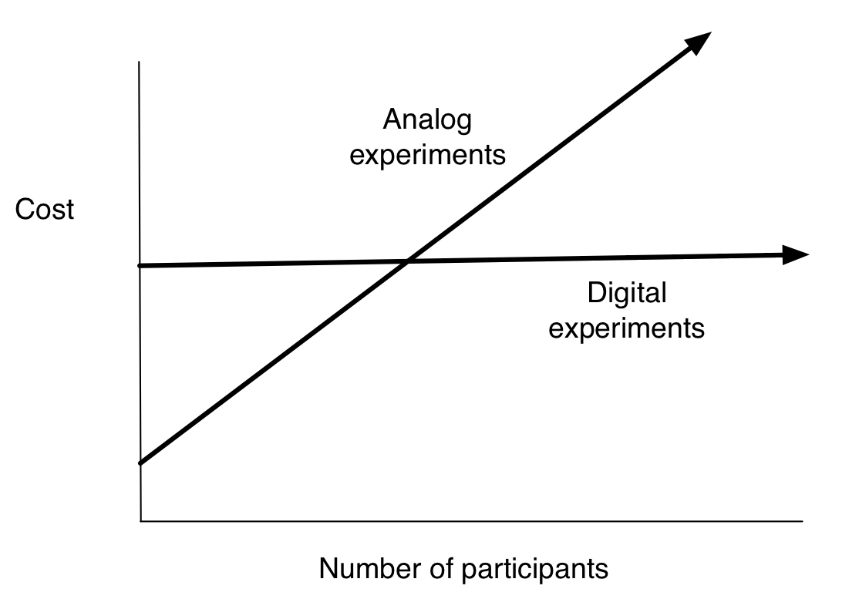
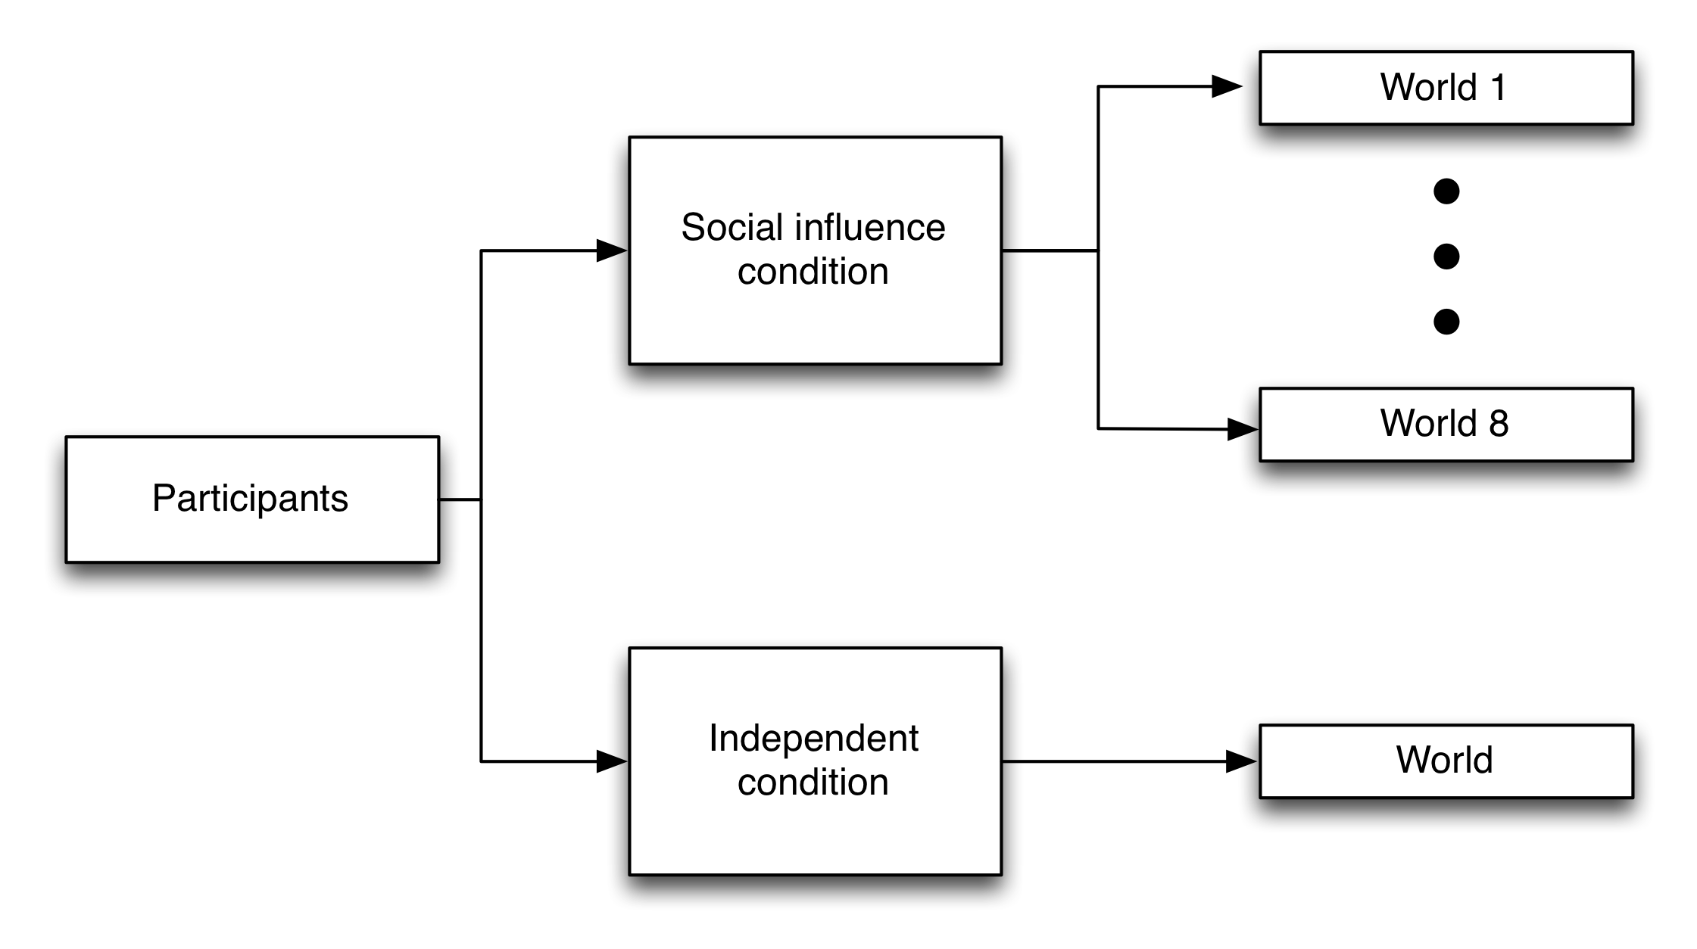
Banner Ads
Recruit participants

Slide 22
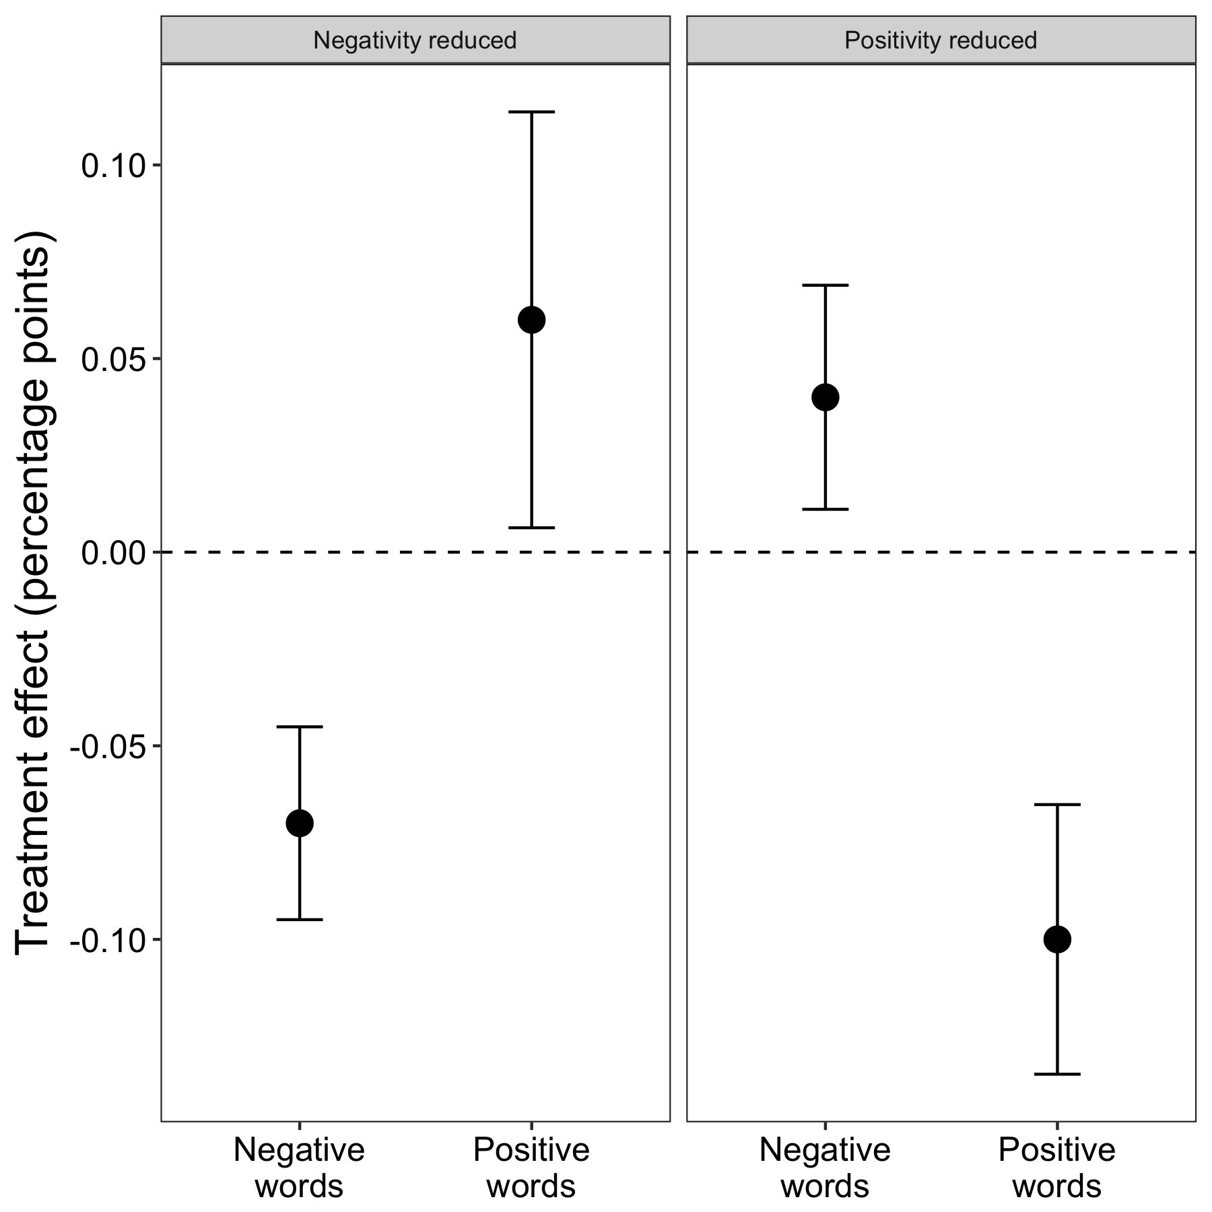
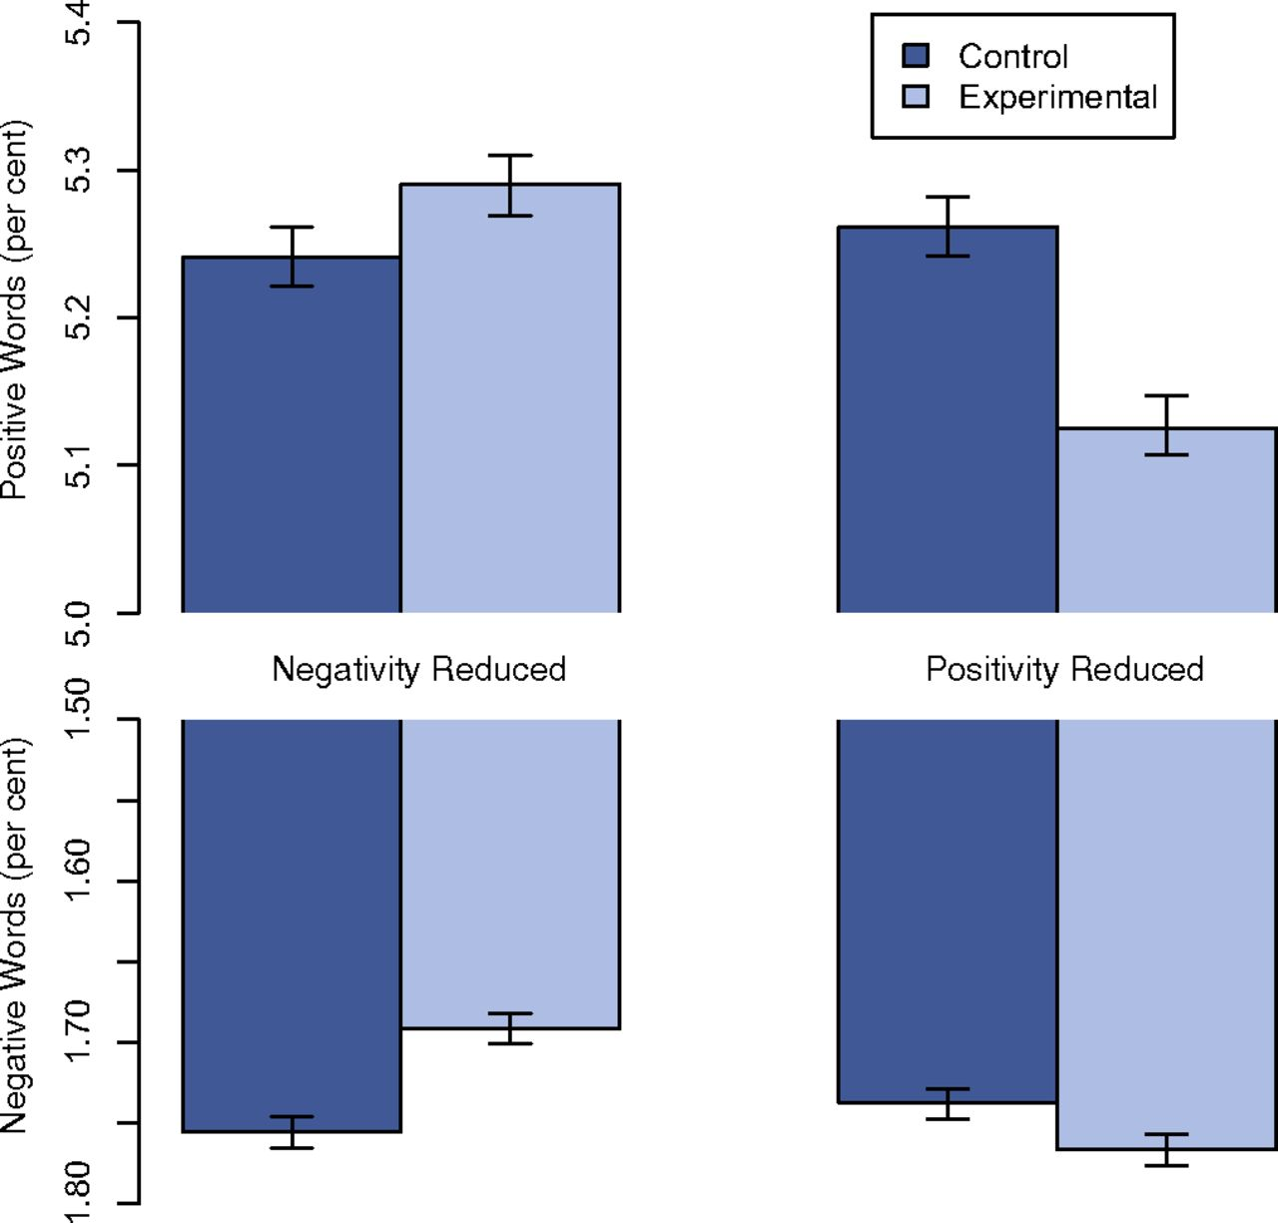

Slide 23
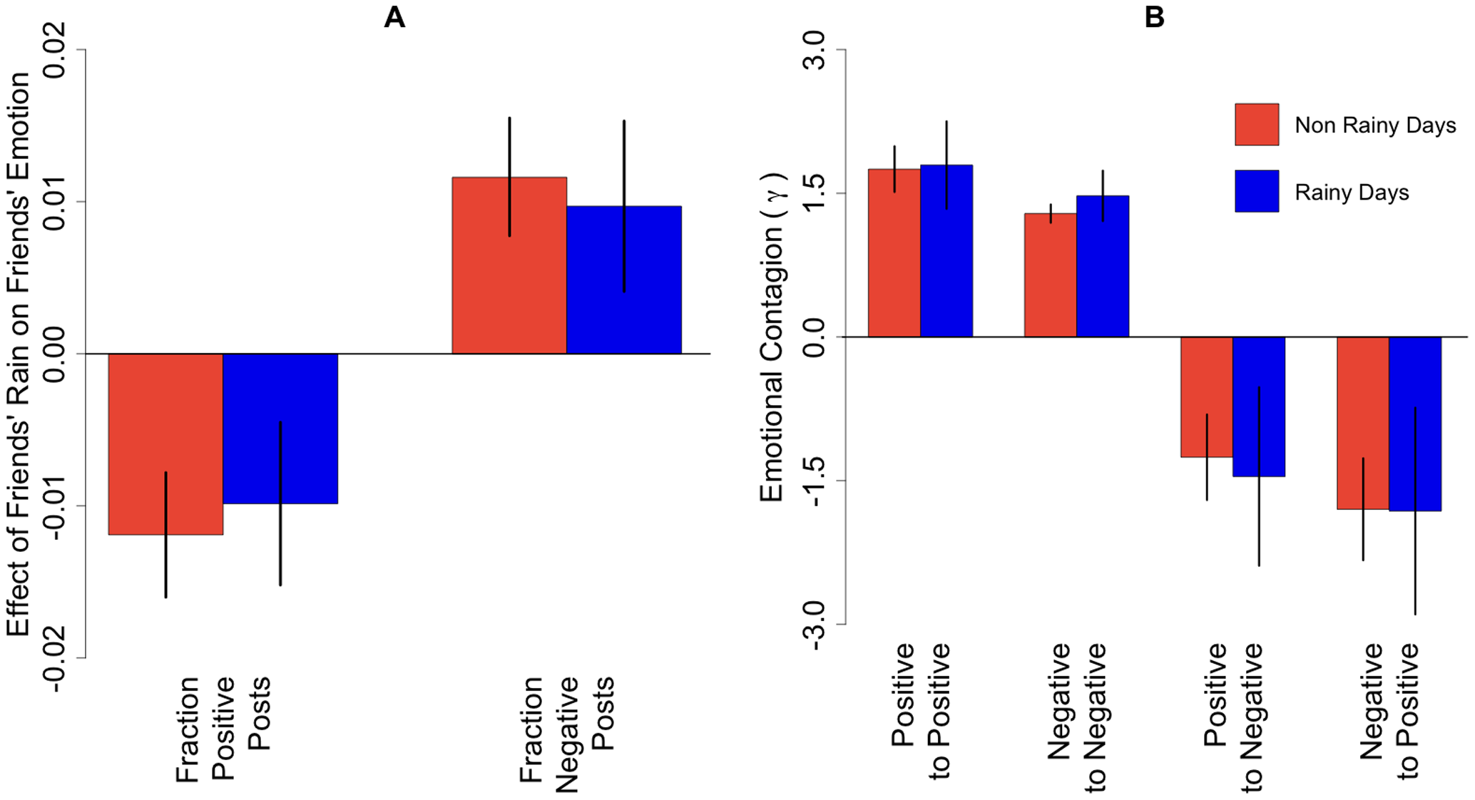





Slide 24

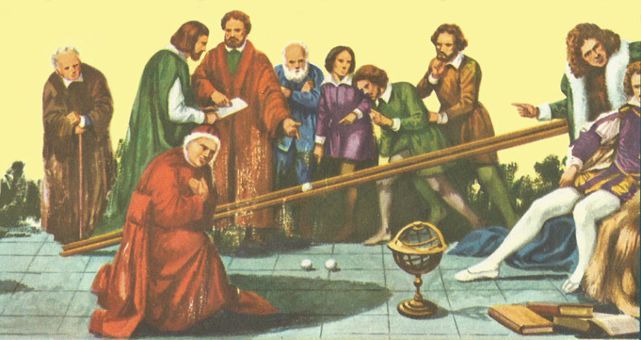
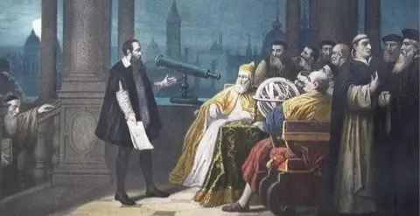
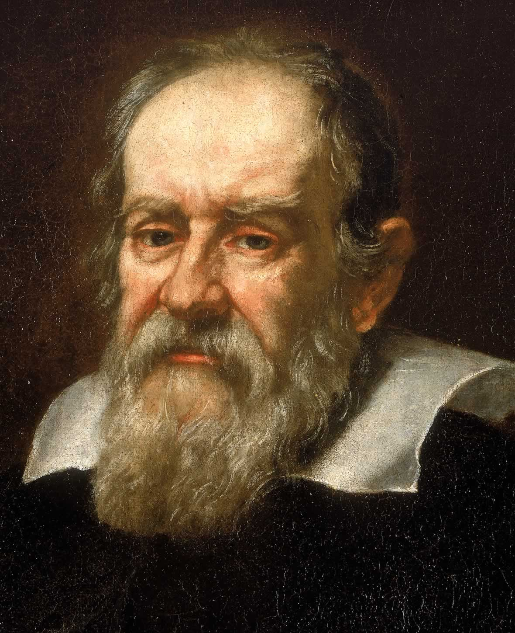


Slide 25
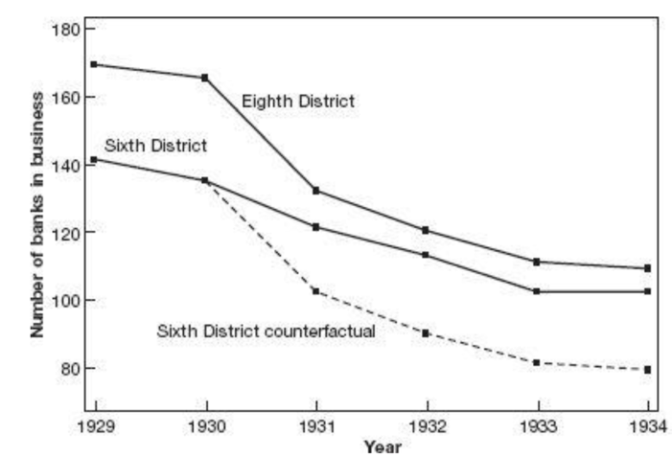
Same Policy

Slide 26
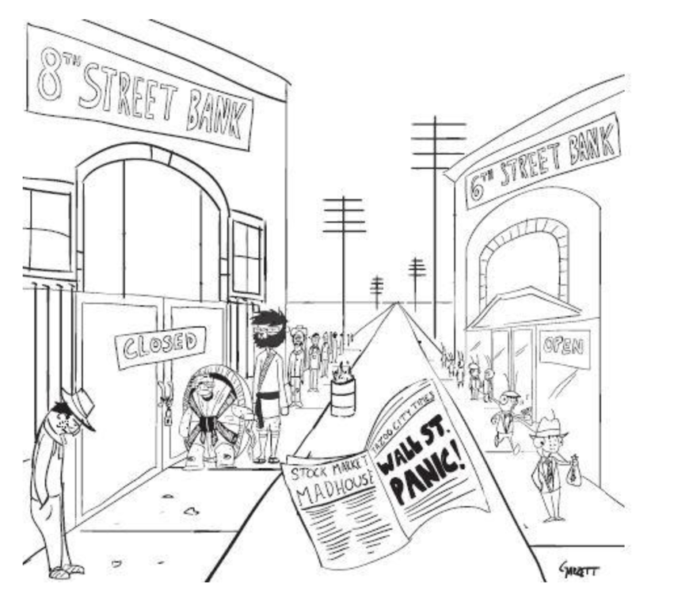
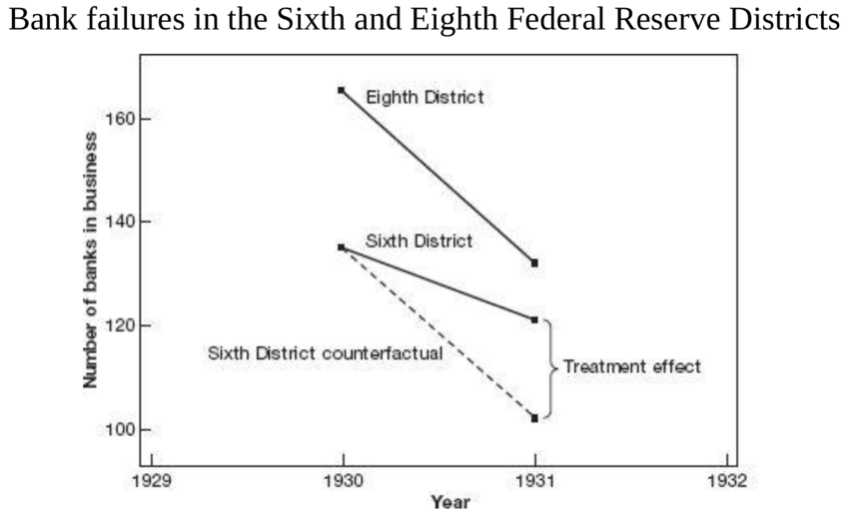

Slide 27
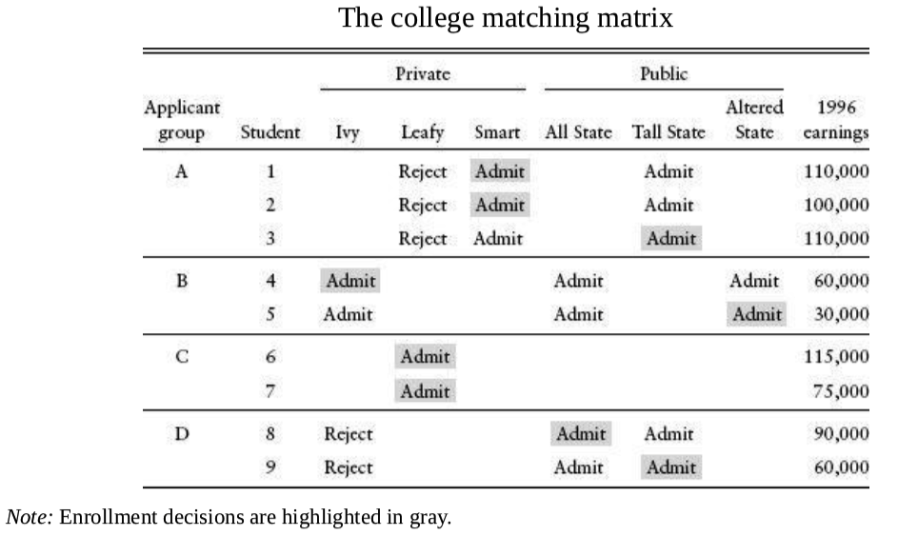
Group A, the private school differential is negative:
(110000+100000)/2−110000=−5000
Group B, the private school differential is positive:
60000−30000=30000
Group C, no public school
Group D, no private school
A tale of two colleges

Slide 28

Instrumental Variables
Regression
Discontinuity
Designs
Regression
Differences-in-Differences
Random Trials

Slide 29


果实---理论
阳光---论证
树叶---论据
树枝---理论假设
树干---理论框架
根系---理论传统
土壤---社会现实问题

Slide 30
A tale of two colleges

Slide 31
A tale of two colleges

Slide 32
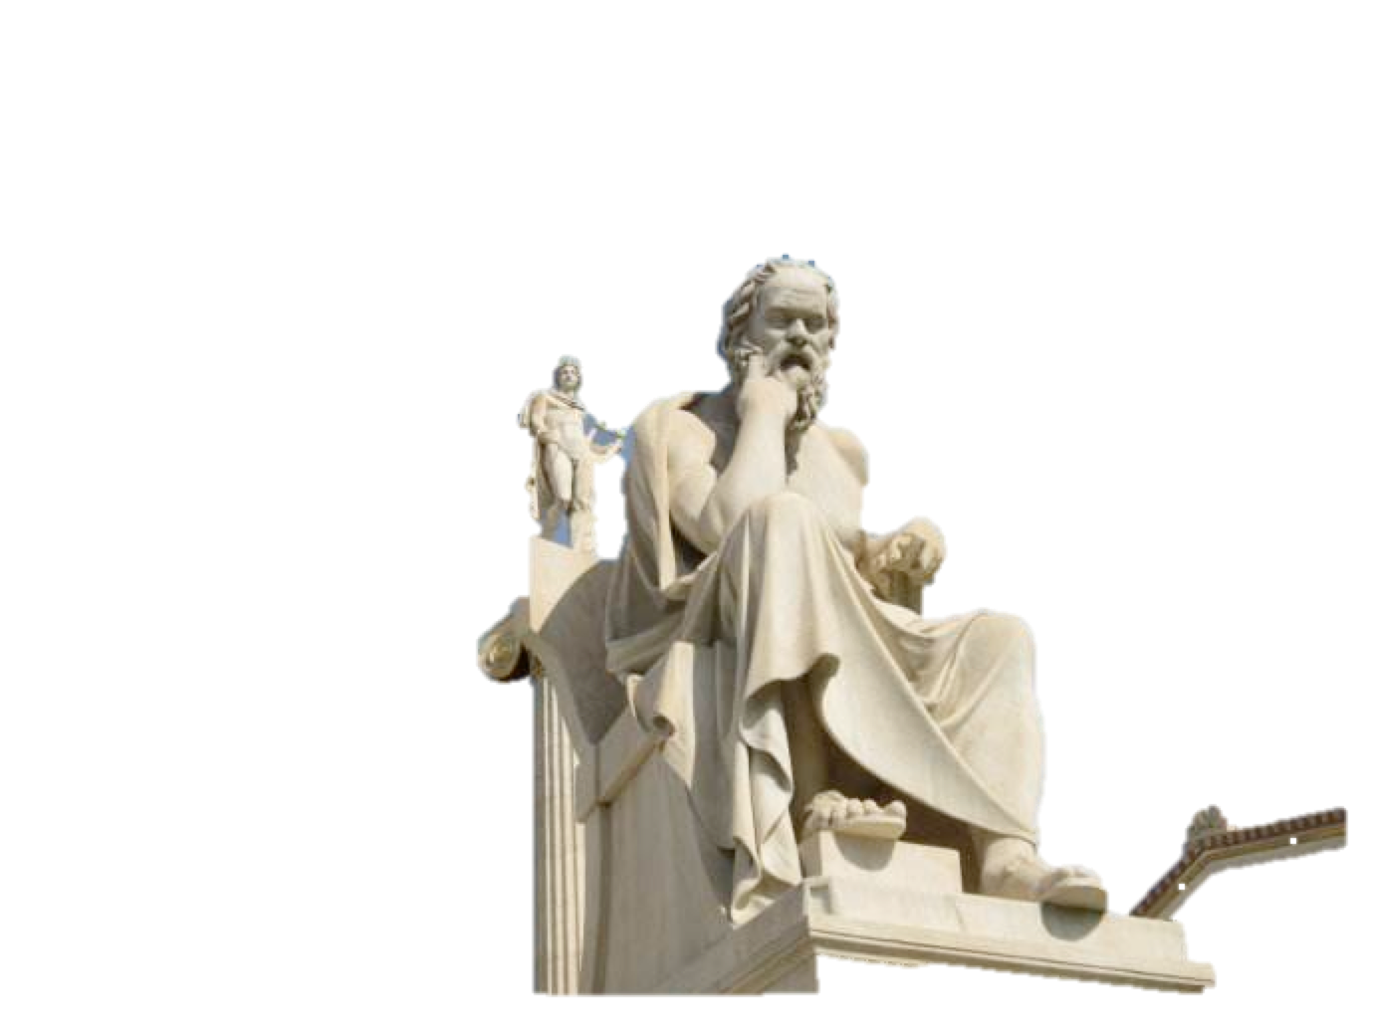
Physics
Computer Science
Biology
Statistical Linguistics
Computability
Network Science
Economics
Psychology
Sociology
Communication
Years since born

Slide 33


Instrumental Variables
Regression
Regression
Discontinuity
Designs
Differences-in-Differences
Random Trials

Slide 34
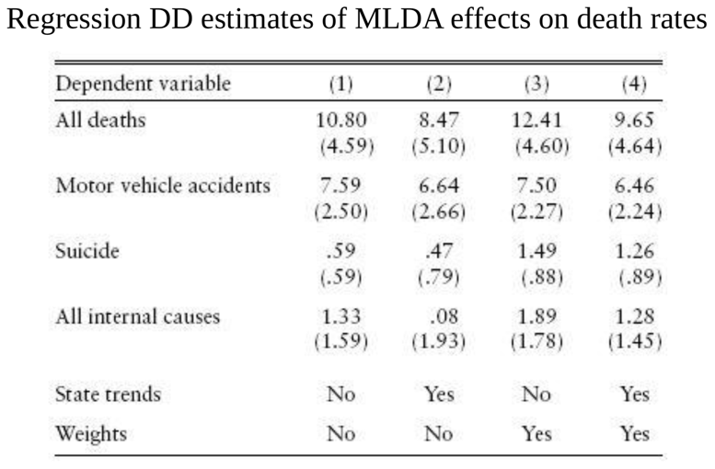
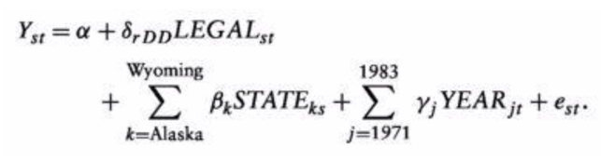
Replacing the interaction term with LEGAL_{st}
Which captures the proportions of 18-20 years old allowed to drink.

Slide 36
